Slide 1
AAA Transportation Training
Megan Johnson – Title III-B Transportation Program Coordinator

Slide 2
Overview
Ice Breaker (10 min)
Title III-B Transportation Crash Course (30 min)
Transportation Training Opportunities (10 min)
Transportation Trends & Updates (20 min)
Waccamaw’s Microtransit Program Presentation (30 min)
Q&A Time (20 min)

Slide 3
Ice Breaker – Transportation Trivia

Slide 4
What is the world’s busiest airport?
Dubai International Airport
B) Atlanta’s Hartsfield-Jackson International Airport
C) London Heathrow Airport
D) Chicago O’Hare International Airport

Slide 5
According to US Traffic standards, what color sign is used as background color for electronic toll collection signs?
A) Blue
B) Green
C) Purple
D) Black

Slide 6
What car model is the best-selling car in the United States?
A) Toyota Camry
B) Chevrolet Silverado
C) Jeep Grand Cherokee
D) Honda Accord

Slide 7
Transportation Crash Course

Slide 8
Types of Transportation
Assisted Transportation
Medical Transportation
Essential Shopping Transportation
Congregate Meal Transportation
Group Transportation
Event Transportation

Slide 9
Assisted Transportation
Door-through-door transportation
Assisted refers to the amount of assistance needed to get a client out of their home, onto the vehicle, and into the location they’re traveling to
Usually billed at a higher unit rate
Wheelchair lifts on a bus does not mean the provider is providing assisted transportation

Slide 10
Example

Slide 11
Medical Transportation
Transportation to or from a medical appointment.
Doctor’s appointment
Hospital
Dialysis

Slide 12
Essential Shopping Transportation
Transportation to a store or location essential to a person’s ability to live independently
Grocery Store
Costco
Wal-Mart (clothes, food, etc)

Slide 13
Congregate Meal Transportation
Transportation to a congregate meal site

Slide 14
Group Transportation
When there is more than one person riding the vehicle
They must get on the vehicle at the same location
They must get off the vehicle at the same location (i.e. senior center or Walmart)
Example: 5 seniors meet at a senior center and are picked up. The 5 seniors are then dropped off at their local Walmart together.

Slide 15
Event Transportation
Transportation to a group event such as Senior Day or the Fair
Allowed 2 per year per provider & must be in state
For reimbursement
Trips must have a reasonable cost
Trips must be approved by the AAA
Trips must have justification in the client financial tracking system
Trips are reimbursed based on the total cost of the trip

Slide 16
Complex Trips
There may be more than one type of transportation in a roundtrip.
Example: On Wednesday there is a group of seniors at a congregate meal site that sign up to go to Walmart. The Walmart is located in a neighboring county. They are taken to the Walmart. Once shopping is completed, the seniors are dropped off at their individual homes.
Congregate site → Walmart = Group
Walmart → homes = Essential Shopping

Slide 17
Billing
Providers get reimbursed for miles that a client is on the vehicle.
When a client is not on a vehicle, the provider cannot charge for reimbursement. These are considered “deadhead” miles.
It is important to set adequate unit rates to account for “deadhead” miles.

Slide 18
AAA Responsibilities Reminder SCDOA PP Ch. 500, section B, 1
1.i For monitoring purposes by the Department on Aging and or AAAs, the providers shall keep the following records:
Driver certified daily driver logs for each vehicle, miles ridden by each passenger (trip starting point and drop-off point), and names of companion riders (this includes Group Transportation trips);
Incident reports for any unexpected event and/or registered complaints with follow-up; and
Daily contributions from riders and fares paid by private pay passengers
1.m The AAA shall, with guidance by the department on Aging Transportation Manager, ensure that the provider maintains an appropriate number of vehicles accessible to persons with disabilities.
1.q The AAA an its providers shall conduct consumer satisfaction evaluations on at least an annual basis. This can be accomplished through various methods including, but not limited to, surveys, interviews, and/or focus groups. This data shall be reviewed by the AAA for program development and made available to the Department on Aging.

Slide 19
Pop Quiz!

Slide 20
Mary uses a wheelchair and is getting transportation to a doctor’s appointment. Mary is outside of her house when the van arrives. Mary has someone assist her with using the wheelchair lift to get onto the van. When the van arrives at the doctor’s office, Mary has assistance using the wheelchair lift to get off of the bus and then enters the office on her own.
A) Medical
B) Assisted
C) Essential
D) Congregate

Slide 21
It’s Wednesday and Tom is getting picked up from his home to go to his congregate meal site with his friends. When Tom gets on the van, four of his friends are already on the van as they have already been picked up from their homes. A short while later, Tom and his friends exit the bus at the congregate meal site.
A) Group
B) Essential
C) Assisted
D) Congregate

Slide 22
At the meal site, Tom and his friends sign up to go to the local Walmart. Tom and his friends board the van and go shopping. After spending all of their remaining money from their retirement checks this month, Tom and his friends go back on the bus and go back to the meal site.
A) Group
B) Essential
C) Assisted
D) Congregate

Slide 23
It is finally time to go home from the congregate meal site. Tom and his friends board the van. The van drops off 2 of Tom’s friends before getting to Tom’s house.
A) Group
B) Essential
C) Assisted
D) Congregate

Slide 24
Rita lives with a mobility disability and uses a wheelchair. Rita is getting transportation to a congregate meal site and requires assistance getting out of her home, onto the vehicle, and then into her destination.
A) Congregate
B) Assisted
C) Accessible
D) Group

Slide 25
Transportation Training Opportunities & Program Updates

Slide 26
Training Opportunities
PASS Statewide Training Update
Other Trainings
PASS Basic Training
$25, in-person
Understanding Passengers Who Have Experienced Trauma
Free, online
Conflict Management and De-escalation for Transit Drivers and Supervisors
Free, online
Recruiting, Building and Retaining a Sustainable Driver Workforce
$150, online
Transportation Diversity, Equity and Inclusion Lunch and Learn Webinar
Free, online

Slide 27
New Transportation TA Webpage
I have been working on creating a Transportation TA Webpage
This will be on the hidden AAA page of aging.sc.gov
Topics addressed will include:
Policy
Training opportunities
Grant opportunities
Resources for transportation updates

Slide 28
New Consumer Satisfaction Tool
Based on requests received during monitoring, a standardized consumer satisfaction tool is going to be created in QuestionPro.
This tool will be optional to use.
The tool is anticipated to be completed by the end of the month.

Slide 29
Transportation Trends & Data

Slide 30
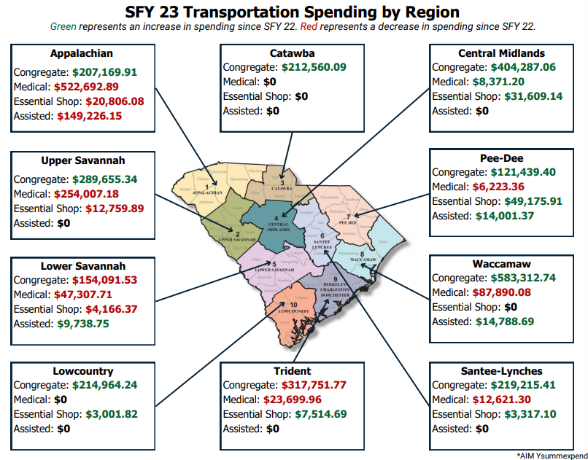
Transportation Spending
All regions saw an increase of spending in at least one type of transportation
All regions offering medical transportation had a decrease in spending compared to last year

Slide 31
Medical Transportation
From January 2023 – October 2023, Medical Transportation has consistently been the #6 presenting need across the state
From January 2023 – June 2023, Medical Transportation was the state’s #3 unmet need
From July 2023 – October 2023, Medical Transportation has been consistent as the state’s #6 unmet need.

Slide 32
Catalytic Converter Theft
40% of providers that have completed the provider survey (n=23) have experienced catalytic converter theft
One provider reported $0 associated with catalytic converter theft because the converters were stolen from a repair shop while the vehicles were receiving maintenance.

Slide 33
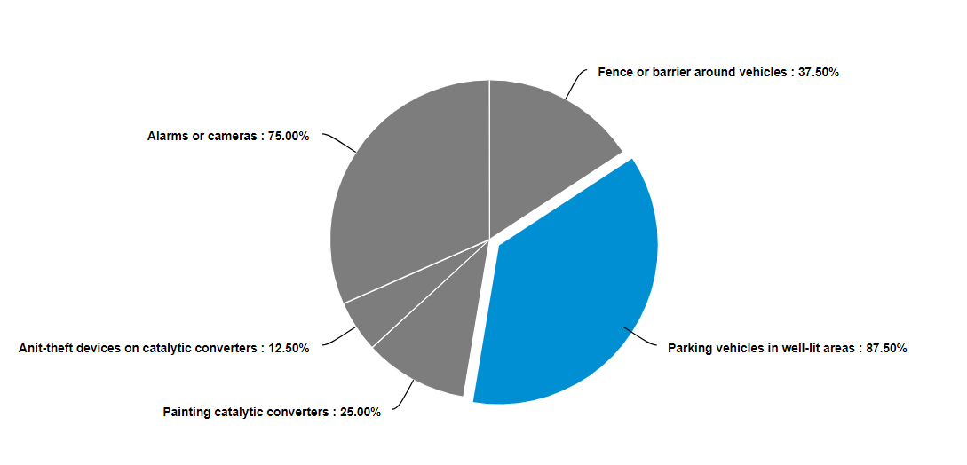
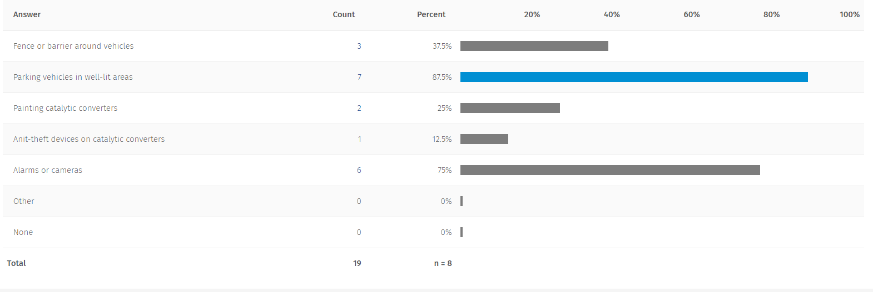
Catalytic Converter Theft Cont.
Of providers who experienced theft and shared protection methods they are using (n=8),
87.5% park vehicles in well-lit areas
75% use alarms or cameras
37.5% use a fence or barrier around their vehicles
25% paint catalytic converters
12.5% use anti-theft devices
All of the providers who have experienced theft are using at least one measure to try to prevent theft.

Slide 34
Driver Shortage
50% of providers that have completed the driver shortage section (n=22) are experiencing a driver shortage

Slide 35
Driver Shortage Cont.
23 reasons were given as to why the providers believe there is a driver shortage
Qualifications / Candidates involved answers related to candidates not being able to pass tests, not being willing to work, and not being qualified.

Slide 36
Waccamaw’s Micro-Transit Program Presentation

Slide 37
Q&A

Slide 38
Answers to Polls
Trivia:
1. B
2. C
3. A
Pop Quiz
1. A
2. D
3. A
4. D
5. B

